Slide 1
Employee Data Analysis using Excel
STUDENT NAME: s.sandhiya
REGISTER NO: 122201772
DEPARTMENT: B.com (corpoeate secretaryship)
COLLEGE: chellammal women's college

Slide 2
PROJECT TITLE
Employee Performance Analysis using Excel

Slide 3


AGENDA
Problem Statement
Project Overview
End Users
Our Solution and Proposition
Dataset Description
Modelling Approach
Results and Discussion
Conclusion
3/21/2024 Annual Review

Slide 4

PROBLEM STATEMENT
problem statement is a description of an issue to be addressed. or a condition to be improved upon. It identifies the gap between the current problem and goal. The first condition of solving a problem is understanding the problem, which can be done by way of a problem statement. https://en.wikipedia.org › wiki › P... Problem statement - Wikipedia

Slide 5

PROJECT OVERVIEW
project overview is a document that summarizes a project's key details, including its goals, objectives, and steps to achieve them. It also outlines the project's schedule, budget, resources, and status. A project overview can help simplify complex information into a single document that can be easily managed throughout the project's lifecycle.
.

Slide 6

WHO ARE THE END USERS?
The end user is the person who will be using the software or program. They are the ones who need to accomplish a task or goal. The end user needs to be able to understand how to use the software or program. They also need to be able to give feedback on their experience.

Slide 7

OUR SOLUTION AND ITS VALUE PROPOSITION
A value proposition is a short statement that communicates why buyers should choose your products or services. It's more than just a product or service description — it's the specific solution that your business provides and the promise of value that a customer can expect you to deliver.

Slide 8
Dataset Description
A Dataset is a set or collection of data. This set is normally presented in a tabular pattern. Every column describes a particular variable. And each row corresponds to a given member of the data set, as per the given question. This is a part of data management.

Slide 9

THE "WOW" IN OUR SOLUTION
The "wow" in a solution can refer to a "wow experience" or "wow factor", which are experiences that exceed customer expectations and leave a lasting
3/21/2024 Annual Review
9

Slide 10
MODELLING
Modeling involves making a representation of something. Creating a tiny, functioning volcano is an example of modeling. Teachers use modeling when they have a class election that represents a larger one, like a presidential election. Modeling is anything that represents something else, usually on a smaller scale.
10

Slide 11

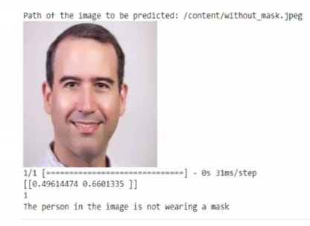
RESULTS
11

Slide 12
conclusion
Our project successfully developed a Convolutional Neural Network (CNN)-based system for face mask detection. •Through meticulous data preprocessing and model training, we achieved promising results in accurately identifying individuals wearing face masks..

